Slide 1
UFC ML Project
File created on: 2/27/2020 9:46:14 PM
Rich Hamilton

Slide 2

Objective
The objective of this project is to utilize machine learning concepts to try to predict the probable outcome of UFC fights based on historical data.

Slide 3
Obtaining the Data
I first thought about using a UFC dataset on kaggle.com only. After further analysis I wanted to obtain the most recent information as possible and utilize a Kaggle dataset (https://www.kaggle.com/rajeevw/UFCdata) .
Also gathered my data from UFC Stats website.

Slide 4
Scrape UFC Website
During our class in week 12 we learned about Web-Scraping. In the span of a week I researched and learned another technique to scrape websites called "Scrapy". This powerful python addon tool is awesome! Try it out to see what your thoughts are.
The link to learn more about Scrapy by going through a tutorial is here.
Installation instruction are here.
By learning the basics of the tool I essentially used Git Bash to write the code to scrape the website of all fighter details including bout information to start my analysis. Utilized Scrapy functions to export scraped data to JSON and CSV files.

Slide 5

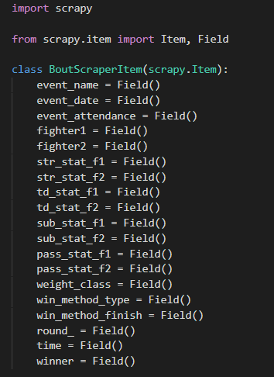
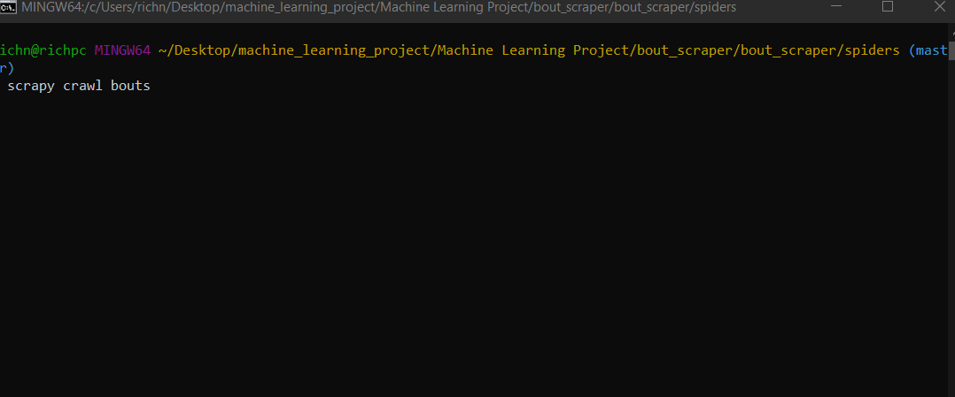
Scrapy

Slide 6
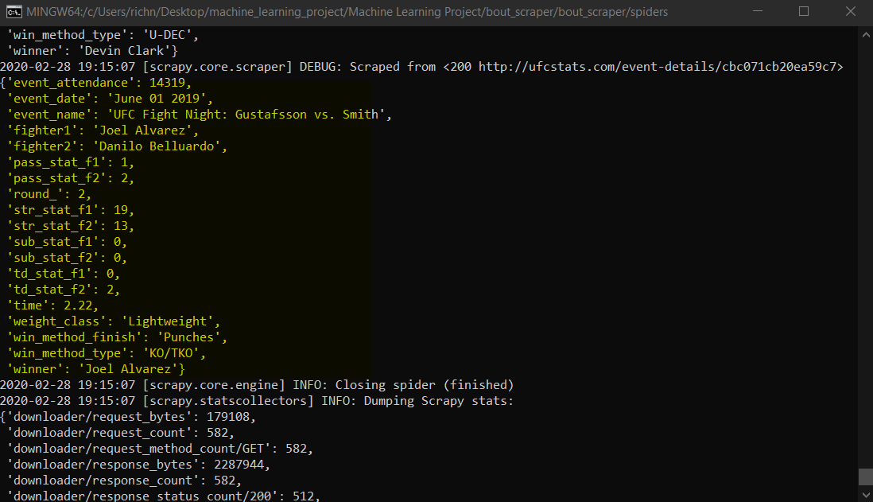
Scrapy

Slide 7

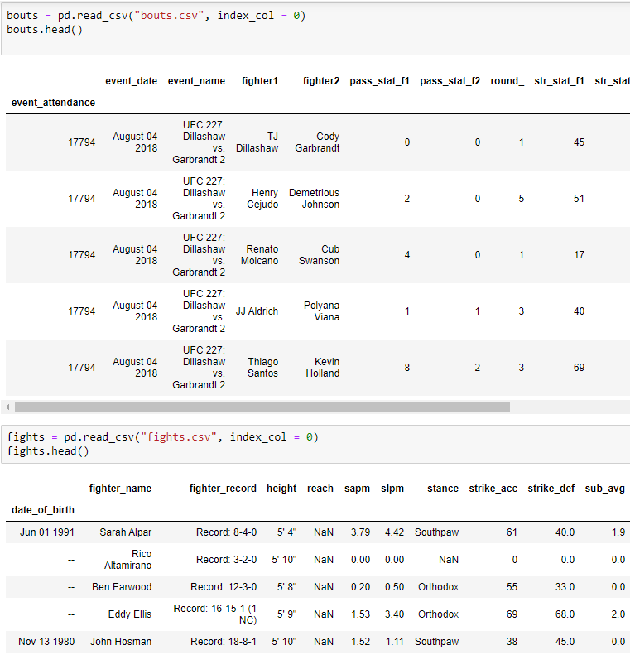
Cleaned CSV files in Jupyter. Datasets stored in Postgres
Extracted the data from UFC Stats (Step 2 provides additional details) and Kaggle, combined the datasets, cleaned the data by dropping rows/columns, converting "NAN" values and converting columns to fractions from percentages. Stored final datasets in Postgres to evaluate potential Visualization needs.

Slide 8
ML Python Pandas & Matplotlib
Utilized the UFC Stats data only at first to find out if a Linear Regression model could be used. Very quickly it was determined that the dataset was very non-linear. I was unable to complete a linear regression model. I figured that other models such as KNN, SVM may vary well provide a good analysis also. My own personal level of comfort and understanding of other models outside of linear regression lead me to choose Random Forest. Selected the data, Trained the model, tested the model, Fitted the model, and made a prediction.

Slide 9

Why?
Random Forest Algorithm…

Slide 10
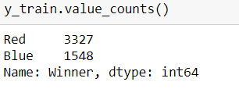
Random Forest
Random forest, like its name implies, consists of a large number of individual decision trees that operate as an ensemble. Each individual tree in the random forest spits out a class prediction and the class with the most votes becomes our model’s prediction.
My row sample is the rows of the winner column (red vs blue).
My feature sample are the columns that outline red & blue statistics such as red’s significant strikes, blue’s significant strikes, etc..
These parameters are passed into the decision trees.
Next In essence with the Decision Tree it has 2 properties
Low Bias
Training errors are less
High Variance
Training data has higher errors.
With the combination of multiple decision trees in essence high variance is converted to low variance by taking the majority vote of multiple decision trees.
Sample size : 4,875 rows

Slide 11
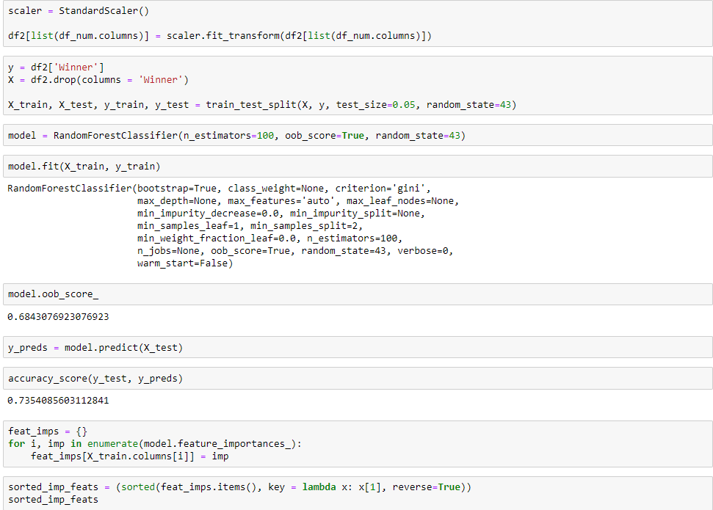
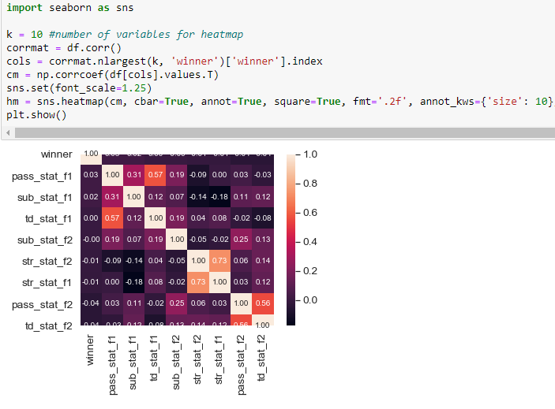
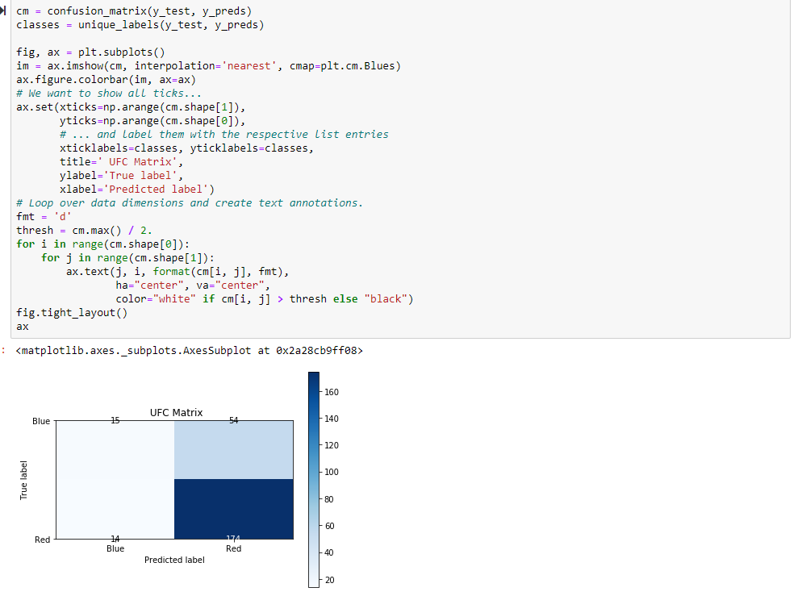
Random Forest

Slide 12
Fun Facts
Items to note:
non-title bouts, the fighter with more name recognition is assigned the red corner. for new-comers fighting ufc vets, the new-comers will always be assigned the blue corner (whether or not they're more known, or they're fighting a less recognizable opponent)
Title Bouts, the champion is assigned to the red corner and the challenger the blue corner.
Red Side seems to win slightly more than blue.
Most winningest fighter in UFC history has fought more on the red side than blue
Ex: UFC 246 Donald Cerrone vs Conor McGregor, Donald Cerrone was in the blue corner. Winner was Conor McGregor

Slide 13
Tableau Visualizations

Slide 14
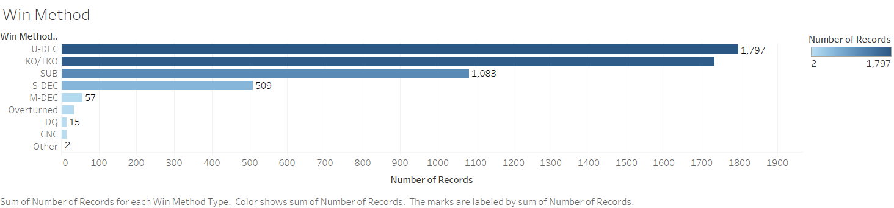

Slide 15
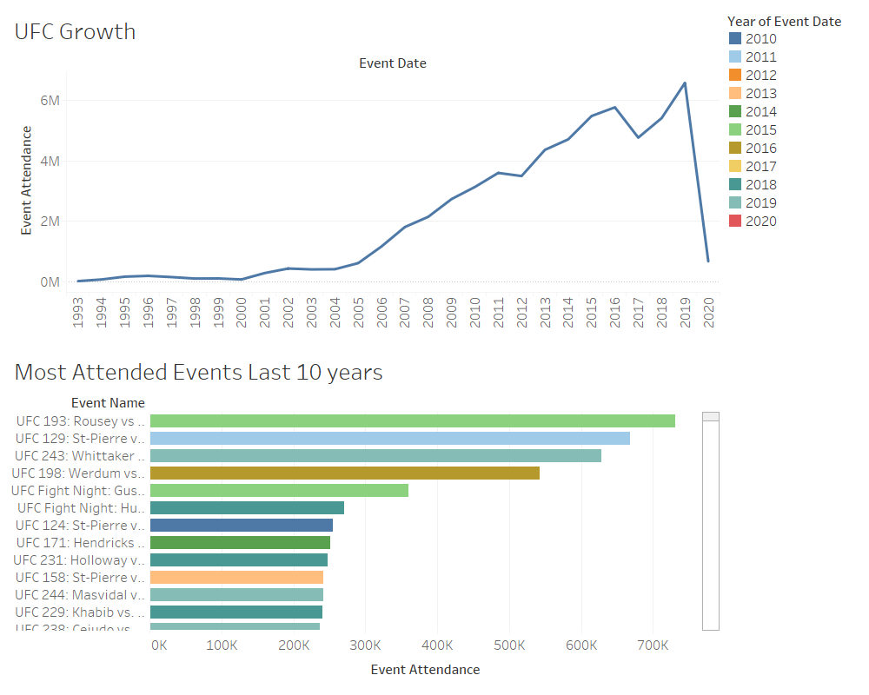

Slide 16
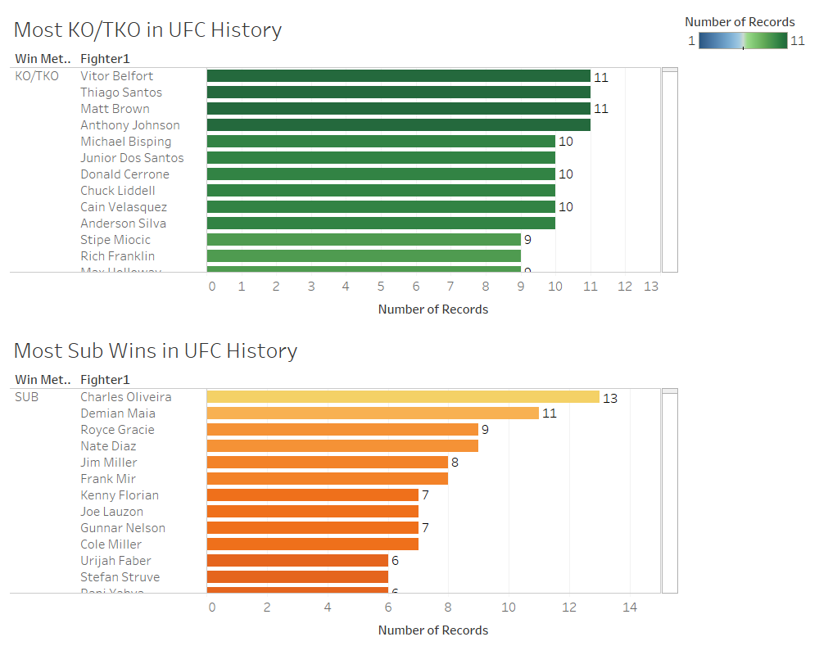

Slide 17
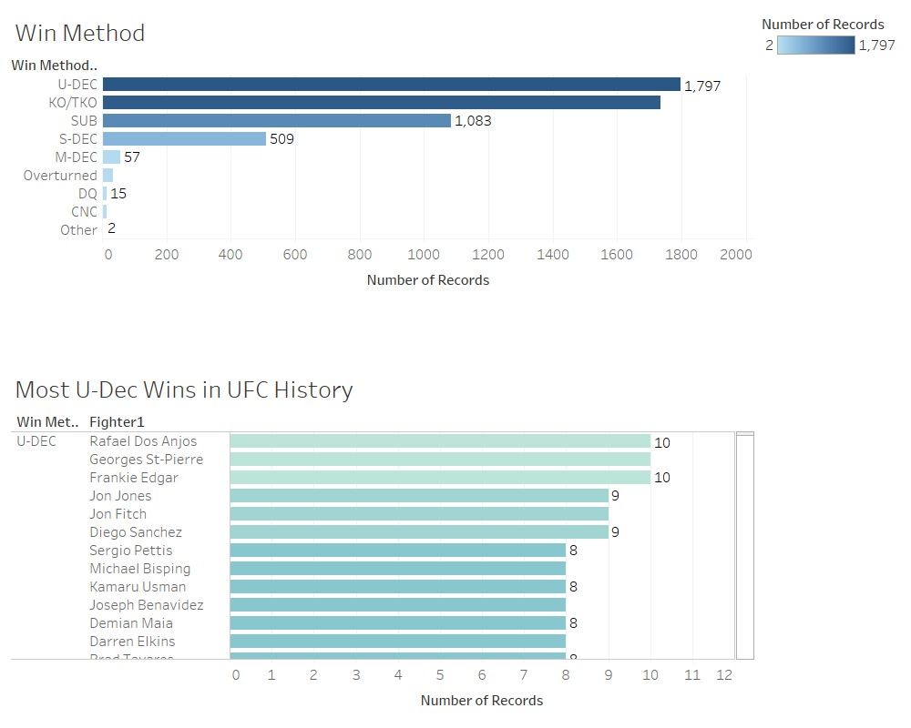

Slide 18
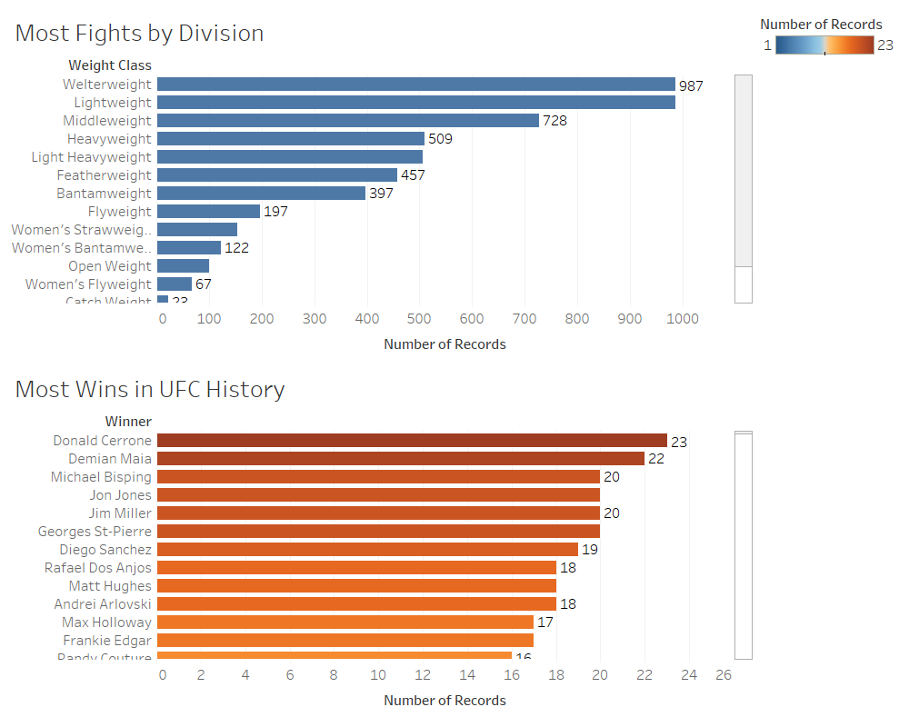

Slide 19
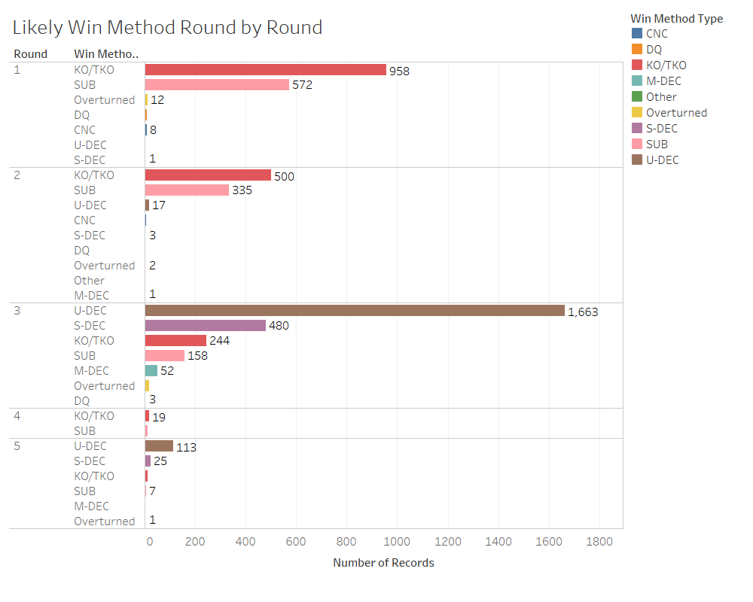

Slide 20

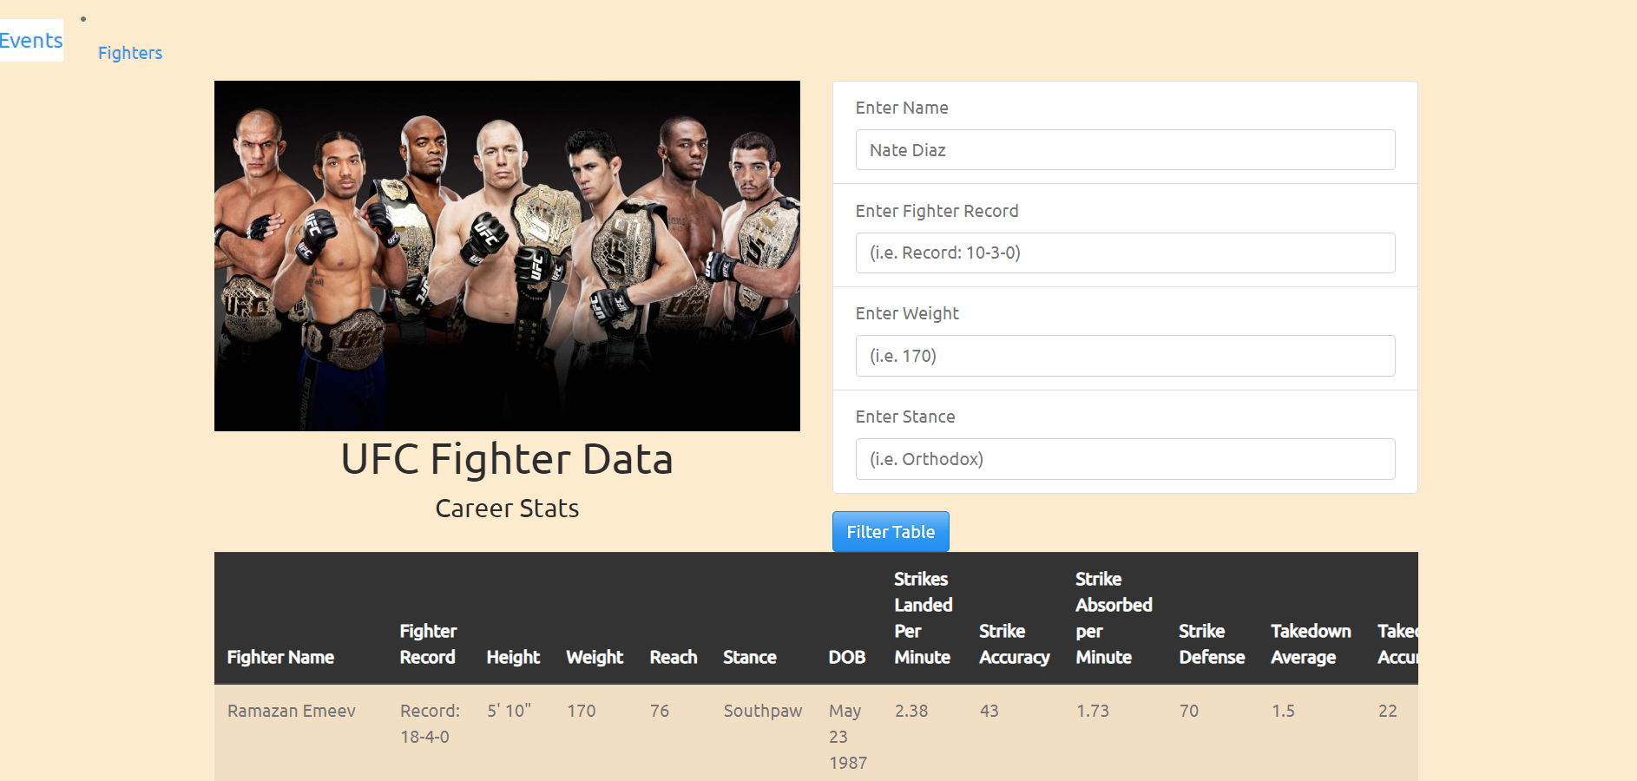
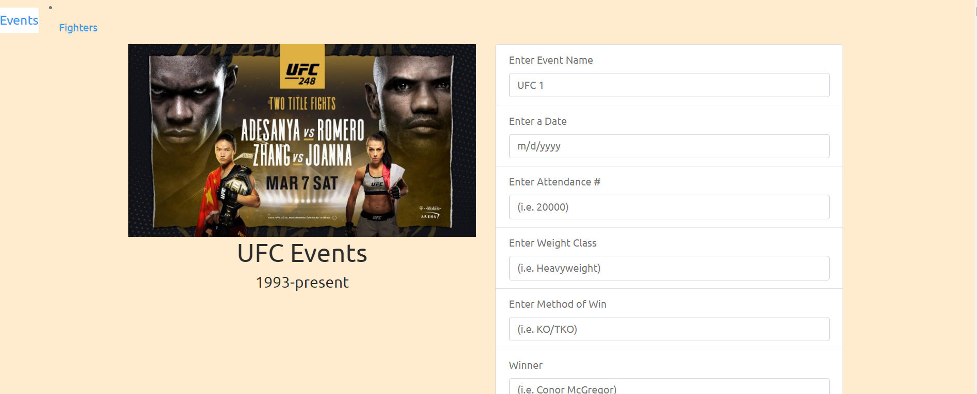
Website
Created website to store data scraped.
HTML/CSS
JS

Slide 21
Final Analysis - ML
Based on the datasets it appears more likely that the red corner is the favorite over the blue corner. The model is having a hard time confirming the reasoning behind this finding. My assumption is due to the nature of the sport and the variety a ways a fighter can win could very well be contributing to this. When in doubt bet the red corner! ☺
Accuracy Score - 73.5%
Model Score - 68.4 %

Slide 22
However….

Slide 23
Disclaimer
I do not condone betting based on the results of this analysis. I am not responsible for any damages done or losses incurred by way of this analysis. ☺

Slide 24
Content
Each row is a compilation of both fighter stats. Fighters are represented by 'red' and 'blue' (for red and blue corner). So for instance, red fighter has the complied average stats of all the fights except the current one. The stats include damage done by the red fighter on the opponent and the damage done by the opponent on the fighter (represented by 'opp' in the columns) in all the fights this particular red fighter has had, except this one as it has not occurred yet (in the data). Same information exists for blue fighter. The target variable is 'Winner' which is the only column that tells you what happened.

Slide 25
Column Definitions
R_ and B_ prefix signifies red and blue corner fighter stats respectively opp containing columns is the average of damage done by the opponent on the fighter
KD is number of knockdowns
SIG_STR is no. of significant strikes 'landed of attempted'
SIG_STR_pct is significant strikes percentage
TOTAL_STR is total strikes 'landed of attempted'
TD is no. of takedowns
TD_pct is takedown percentages
SUB_ATT is no. of submission attempts
PASS is no. times the guard was passed?
REV are the number of reversals
HEAD is no. of significant strikes to the head 'landed of attempted'
BODY is no. of significant strikes to the body 'landed of attempted'
CLINCH is no. of significant strikes in the clinch 'landed of attempted'
GROUND is no. of significant strikes on the ground 'landed of attempted'
win_by is method of win
last_round is last round of the fight (ex. if it was a KO in 1st, then this will be 1)
last_round_time is when the fight ended in the last round
Format is the format of the fight (3 rounds, 5 rounds etc.)
Referee is the name of the Ref
date is the date of the fight
location is the location in which the event took place
Fight_type is which weight class and whether it's a title bout or not
Winner is the winner of the fight
Stance is the stance of the fighter (orthodox, southpaw, etc.)
Height_cms is the height in centimeter
Reach_cms is the reach of the fighter (arm span) in centimeter
Weight_lbs is the weight of the fighter in pounds (lbs.)
age is the age of the fighter
title_bout Boolean value of whether it is title fight or not
weight class is which weight class the fight is in (Bantamweight, heavyweight, Women's flyweight, etc.)
no_of_rounds is the number of rounds the fight was scheduled for
current_lose_streak is the count of current concurrent losses of the fighter
current_win_streak is the count of current concurrent wins of the fighter
draw is the number of draws in the fighter's UFC career
wins is the number of wins in the fighter's UFC career
losses is the number of losses in the fighter's UFC career
total_rounds_fought is the average of total rounds fought by the fighter
total_time_fought(seconds) is the count of total time spent fighting in seconds
total_title_bouts is the total number of title bouts taken part in by the fighter
win_by_Decision_Majority is the number of wins by majority judge's decision in the fighter's UFC career
win_by_Decision_Split is the number of wins by split judges' decision in the fighter's UFC career
win_by_Decision_Unanimous is the number of wins by unanimous judges' decision in the fighter’s UFC career
win_by_KO/TKO is the number of wins by knockout in the fighter's UFC career
win_by_Submission is the number of wins by submission in the fighter's UFC career
win_by_TKO_Doctor_Stoppage is the number of wins by doctor stoppage in the fighter's UFC career

Slide 26
THE END

